Slide 1
The Honey Badger of BFT Protocols
Author: Andrew Miller, Yu Xia, Kyle Croman, Elaine Shi, Dawn Song
Presenter: Zaoyi Zheng, Weijia Wang, Jinxiao Yu
Date: Nov 15, 2021

Slide 2
Roadmap
Background & Brief Introduction(Zheng)
Overall Flow & ACS Algorithm(Wang)
ABA Algorithm & Benchmark & Questions(Yu)

Slide 3
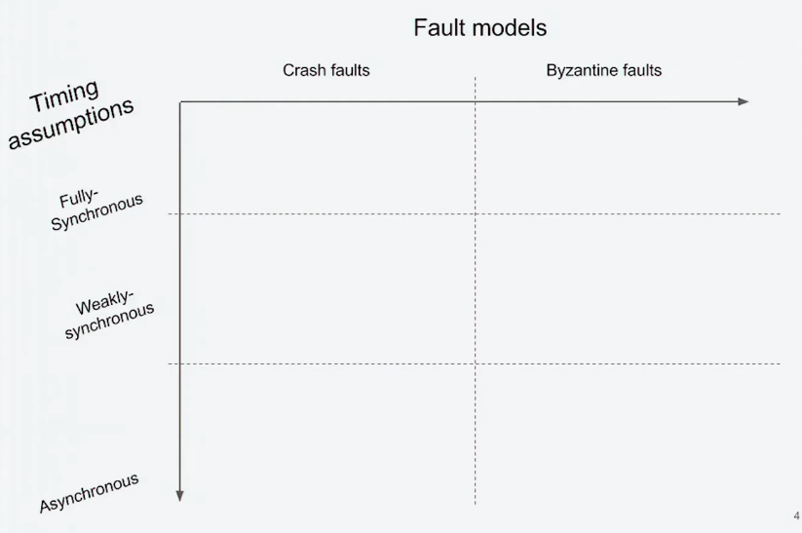
Permissioned Ledger Protocols

Slide 4
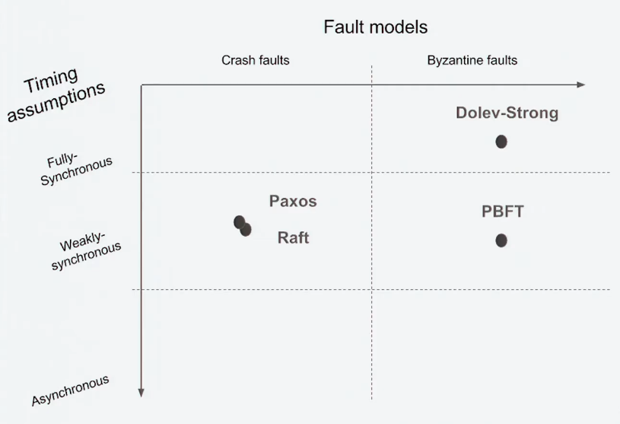
Permissioned Ledger Protocols

Slide 5
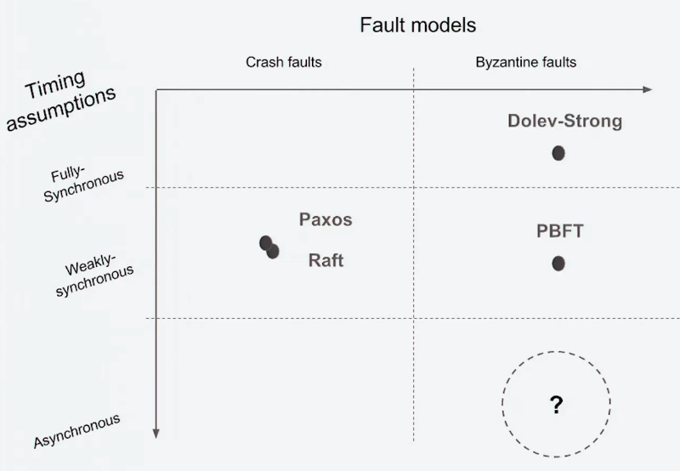
Permissioned Ledger Protocols

Slide 6

Briefly introduction: HoneyBadgerBFT
The first practical asynchronous BFT protocol.
Improve the throughput by O(N^2)
Honey Badger BFT guarantees liveness without making timing assumptions.
No Leader likes traditional synchrony BFT protocols.
Notes:
What is time assumptions, we will discuss in the next

Slide 7
Question
Why we should prefer asynchronous protocols?
The limitations of traditional synchronous protocols?
The differences between them?

Slide 8
Differences between
synchronous and asynchronous protocols
(Full) Synchrony: all messages are delivered within Δ time
Eventual Synchrony: after unknown time GST, all messages delivered within Δ
Partial Synchrony: Δ is unknown to the protocol
Weak Synchrony: Δt is time varying, but grows polynomially in t
Asynchronous: all messages are eventually delivered

Slide 9
Differences between
synchronous and asynchronous protocols
(Full) Synchrony: all messages are delivered within Δ time
Eventual Synchrony: after unknown time GST, all messages delivered within Δ
Partial Synchrony: Δ is unknown to the protocol
Weak Synchrony: Δt is time varying, but grows polynomially in t
Asynchronous: all messages are eventually delivered

Slide 10
Flow of typical synchrony BFT protocols
Start with a Leader and a timeout parameter Δ

Slide 11
Flow of typical synchrony BFT protocols
Start with a Leader and a timeout parameter Δ
If Leader is uncorrupted, timeout parameter Δ are suitable, and messages delivered within Δ, then the “fast path” portion of the protocol succeeds

Slide 12
Flow of typical synchrony BFT protocols
Start with a Leader and a timeout parameter Δ
If Leader is uncorrupted, timeout parameter Δ are suitable, and messages delivered within Δ, then the “fast path” portion of the protocol succeeds
Otherwise, elect a new Leader, or increase the timeout Δ
View- Change

Slide 13
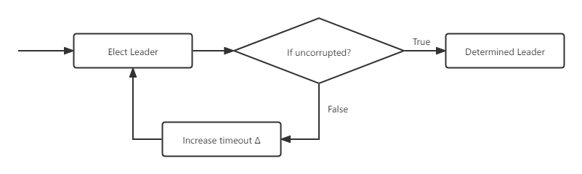
Limitations of electing Leader

Slide 14
Limitations of electing Leader
Proof sketch: eventually, Δ is large enough and Leader is uncorrupted

Slide 15
Unavoidable dilemma
when tuning parameters - Δ
timeout parameter Δ is too small or increase too slow
Relies on accurate estimate of network latency
timeout parameter Δ is too large or increase too fast
Recovers slowly from intermittent partitions
It is a tradeoff between robustness and responsiveness.

Slide 16
Unavoidable dilemma
when tuning parameters - Δ
timeout parameter Δ is too small or increase too slow
Relies on accurate estimate of network latency
timeout parameter Δ is too large or increase too fast
Recovers slowly from intermittent partitions
It is a tradeoff between robustness and responsiveness.
Asynchronous protocols have no timing parameters to tune at all.

Slide 17
Asynchronous Protocol
Robustness is a first-class citizen.
Honey Badger BFT guarantees robustness WITHOUT making time assumptions.

Slide 18
Asynchronous Protocol
Robustness is a first-class citizen.
Honey Badger BFT guarantees robustness WITHOUT making time assumptions.
Favor throughput over latency.
Response time and contention are NOT the most critical factors.

Slide 19
Asynchronous Protocol
Robustness is a first-class citizen.
Honey Badger BFT guarantees robustness WITHOUT making time assumptions.
Favor throughput over latency.
Response time and contention are NOT the most critical factors.
Point-to-Point
When a process receives a message, it can identify its sender.

Slide 20
Honey Badger BFT Protocol
Asynchronous
A message that has been sent is eventually received by its destination process, i.e., there is no bound on message transfer delays.
Reliable
The network does not loss, duplicate, modify, or create messages.
No LEADER likes traditional synchrony BFT protocols.
Transactions are chosen by adversary and provided as input to the nodes.

Slide 21
Protocol Assumptions:
Purely asynchronous network
Assume each pair of nodes is connected by a reliable authenticated point-to-point channel that does not drop messages.
Static Byzantine Faults
3f +1 ≤ N
Trusted Setup
Nodes may interact with a trusted dealer during an initial protocol-specific setup phase to establish public keys and secret shares.
Notes:
Trusted Setup is imcompleted

Slide 22
Honey Badger BFT Protocol
Adapt synchronous BFT for efficiency in the batch setting
1. Improve by O(N) by “refactoring” with known(but overlooked) primitives
2. Improve by another O(N) by using random selection and threshold encryption
Totally O(N^2) improvement

Slide 23
Honey Badger BFT
Algorithm

Slide 24
Basic prerequisites
Erasure codes
Merkle Tree
Threshold Encryption

Slide 25
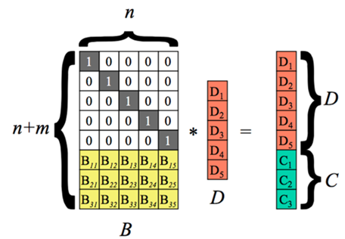
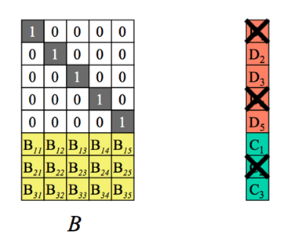
Erasure Codes
Divide message into n pieces and transmit to other nodes
Reconstruct the message from the pieces
Tolerate the loss of up to m pieces of data

Slide 26
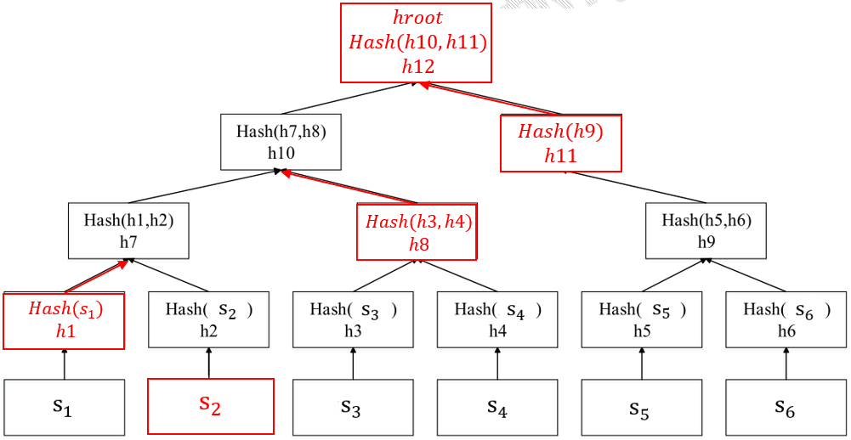
Merkle Tree
s: leaf node
b: path to root
h: hroot
e.g.: Given s2 and path={h1,h8,h11}, we can calculate the root of this Merkle Tree

Slide 27
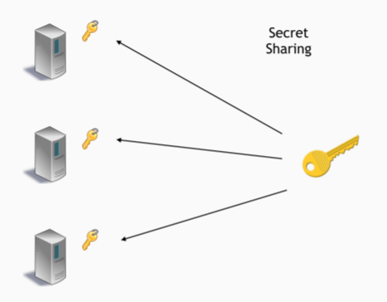
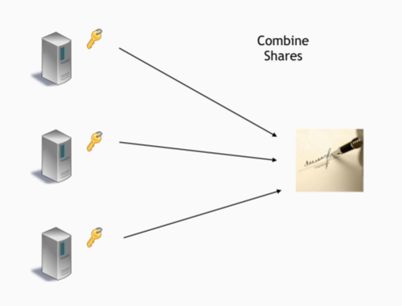
Threshold Encryption
A Threshold Encryption scheme TPKE is a cryptographic primitive that allows any party to encrypt a message to a public key, such that the network nodes must work together to decrypt it (using their secret keys).
Once f + 1 correct nodes compute and reveal decryption shares for a ciphertext, the plaintext can be recovered.

Slide 28
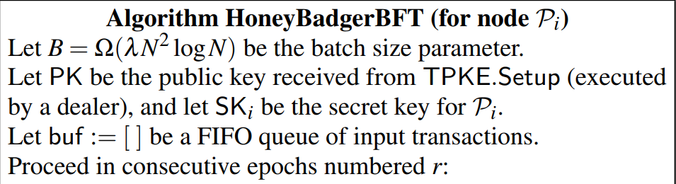
Basic Parameters
For node Pi:
buf: buffer
B: Batch Size
PK: Public Key
SK: Secret Key
N nodes
Epoch number r
Each node is the leader of its own protocol.

Slide 29
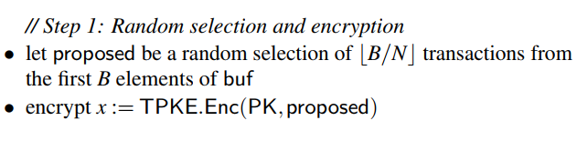
1. Random Selection and Encryption
Propose [B/N] transactions from buffer.
Encrypt to ciphertexts x using Public Key.
Random Selection: To avoid redundant transactions.

Slide 30
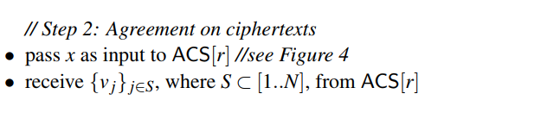
2. Agreement on ciphertexts
Input x to ACS blackbox.
ACS outputs a set of ciphertexts which come from correct nodes.

Slide 31
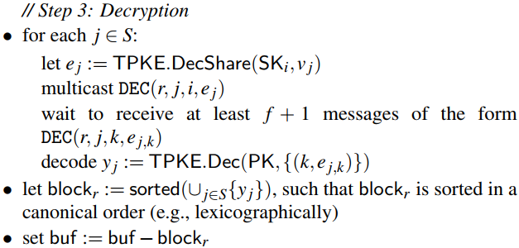
3. Decryption
Loop through cipher set.
Broadcast decryption shares.
Decode transactions.
Store transactions in block.
Remove transactions from buffer.

Slide 32
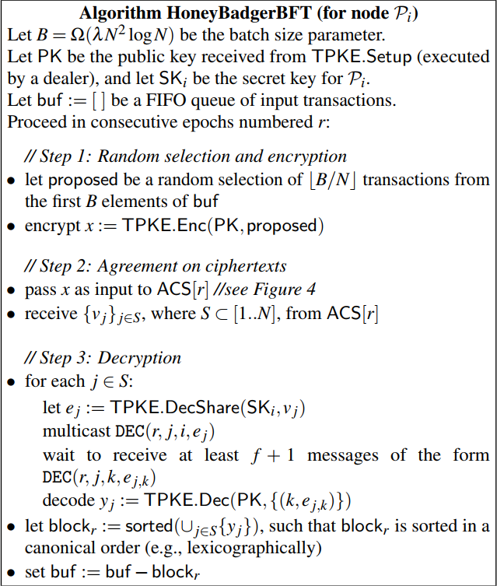
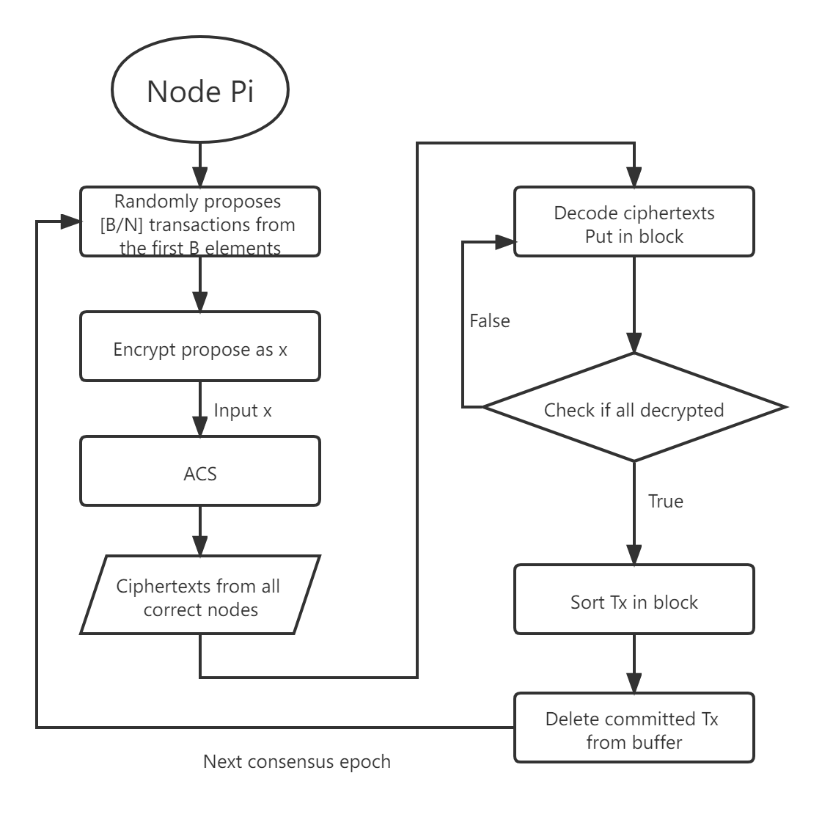

Slide 33
Randomly proposes [B/N] transactions from buffer and encrypt to PK.
Reach consensus in blackbox of Asynchronous Common Subset (ACS).
Receive ciphertexts of other nodes.
Decrypt ciphertexts set output by ACS, delete those transactions from buffer.
Next epoch

Slide 34
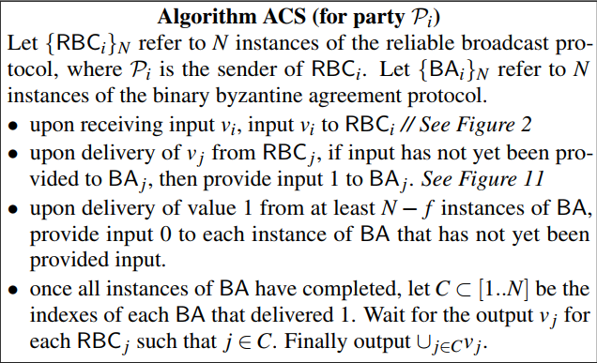
Asynchronous Common Subset (ACS)
Consists of two protocols:
Reliable Broadcast (RBC)
Asynchronous Binary Byzantine Agreement (ABA)

Slide 35
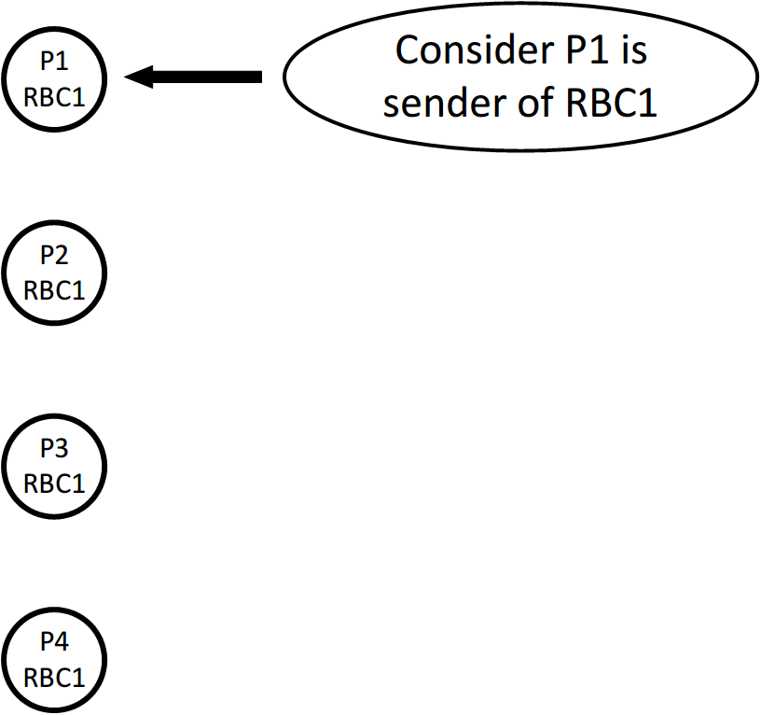
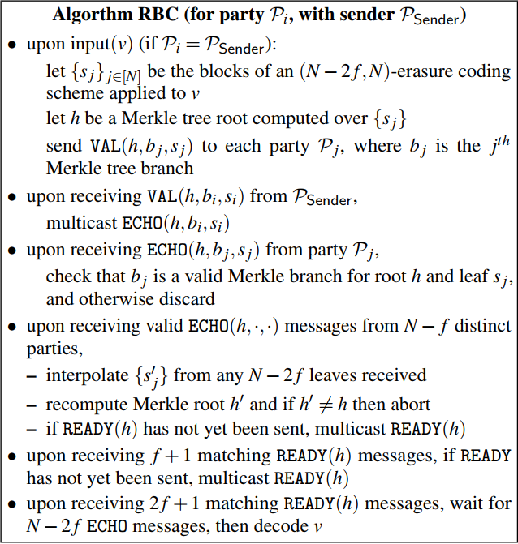
Reliable Broadcast (RBC)

Slide 36
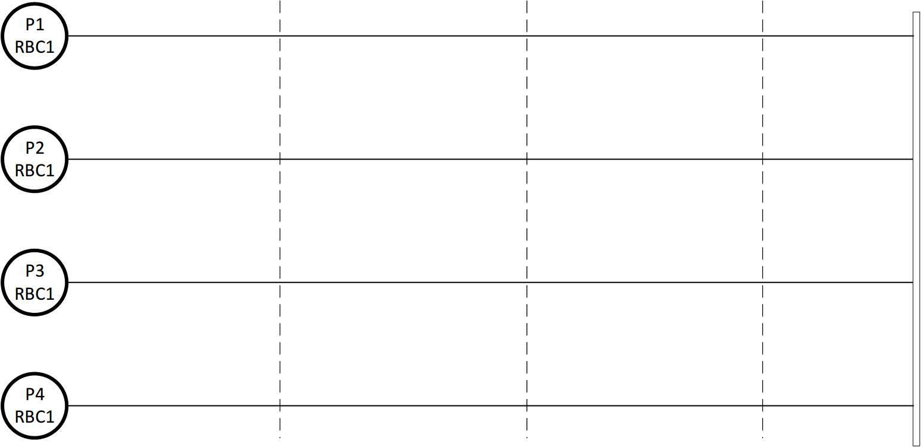

Slide 37
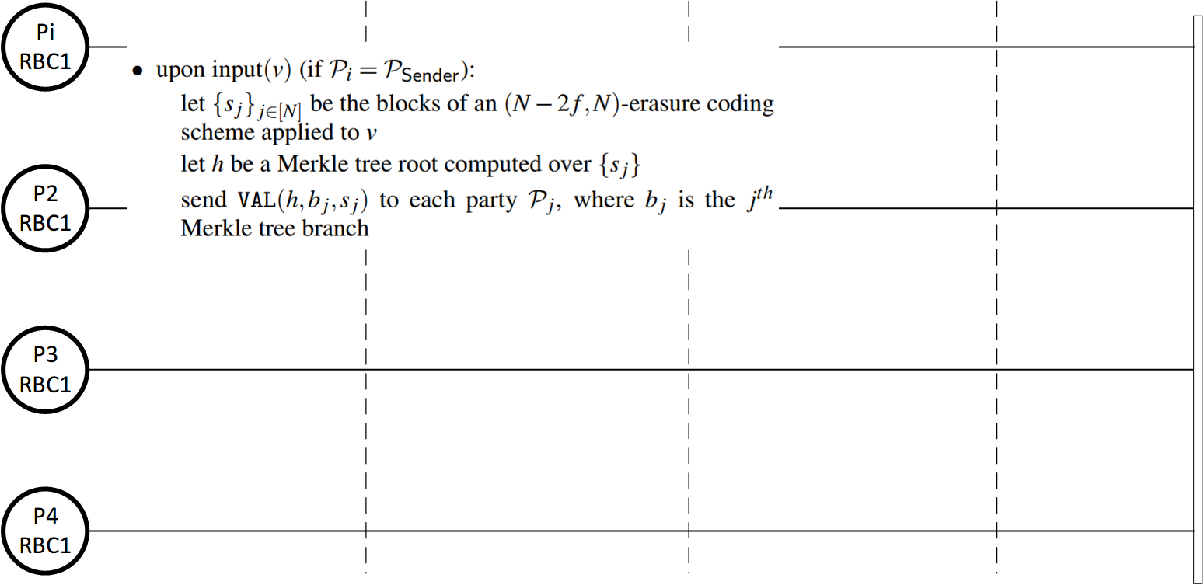

Slide 38
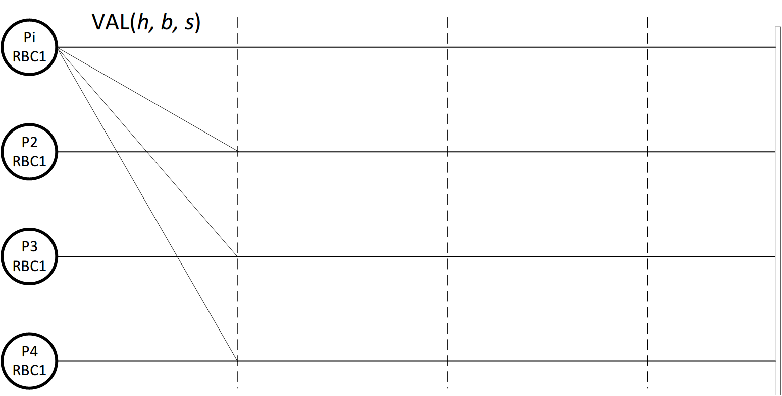

Slide 39
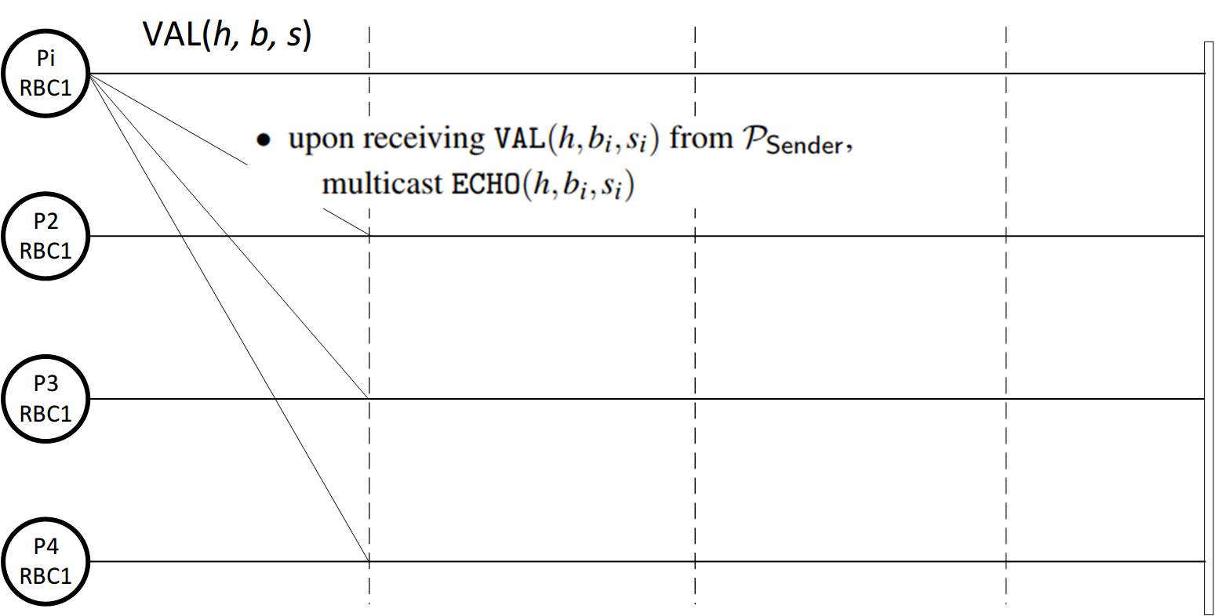

Slide 40
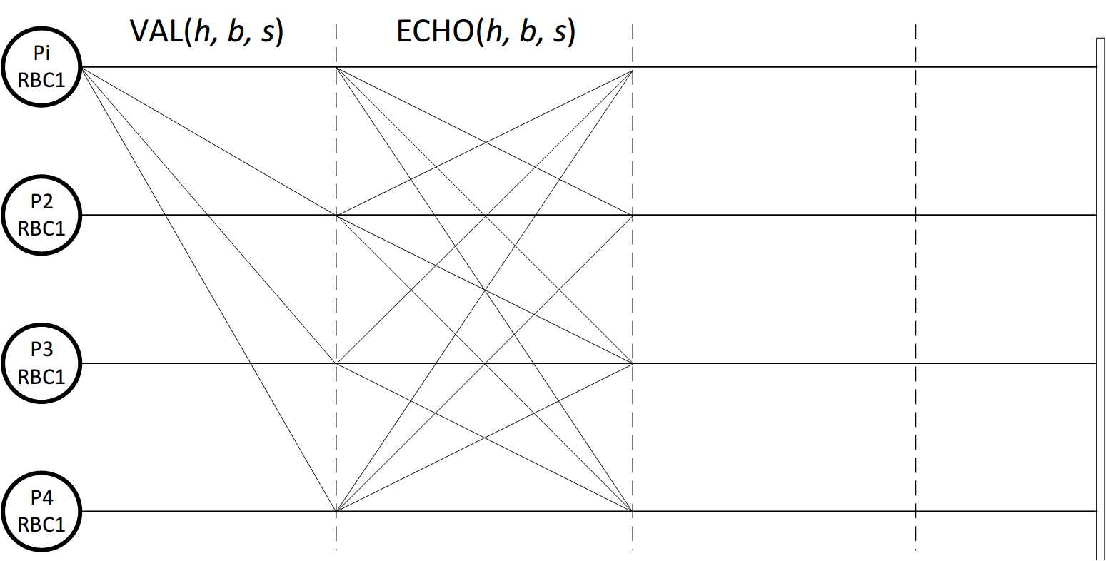

Slide 41
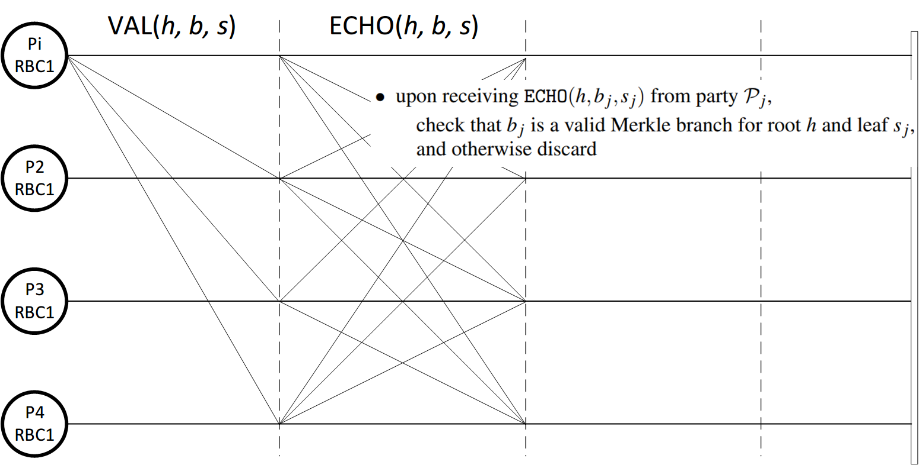

Slide 42
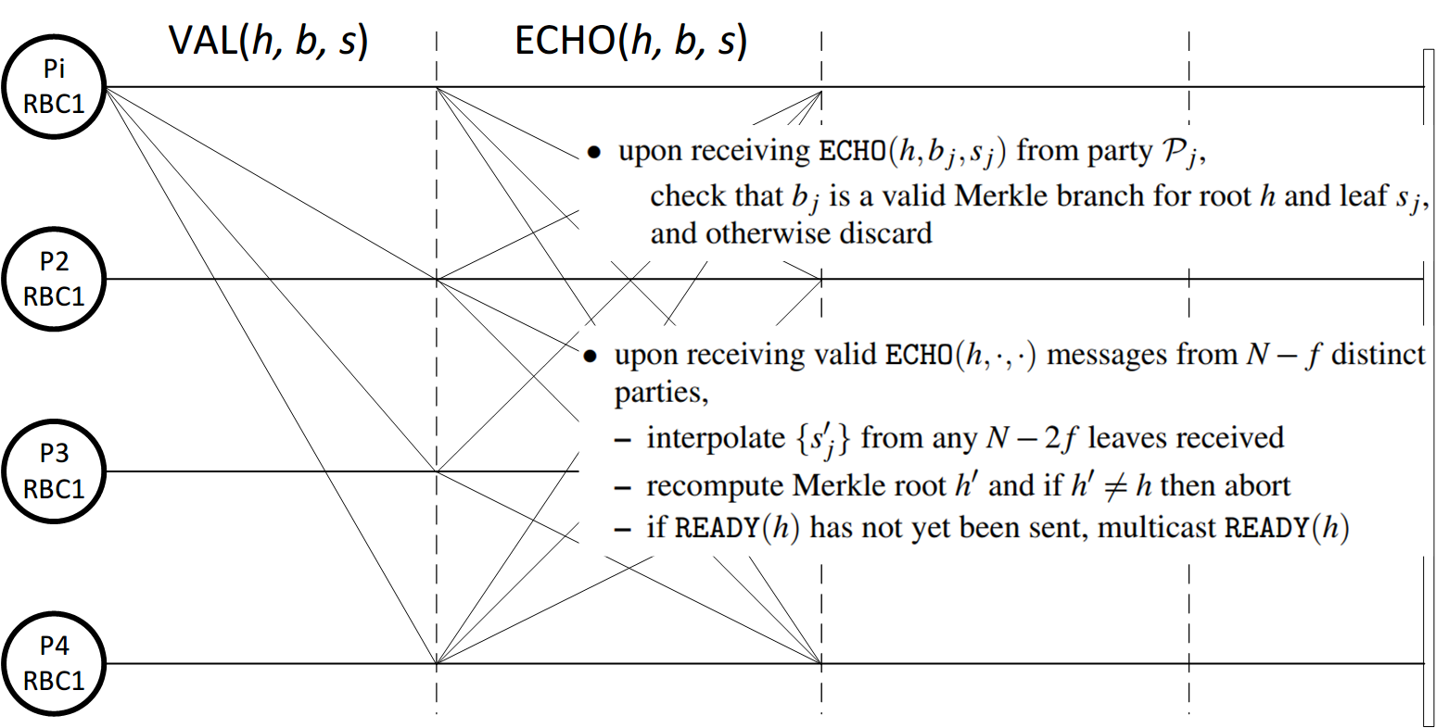

Slide 43
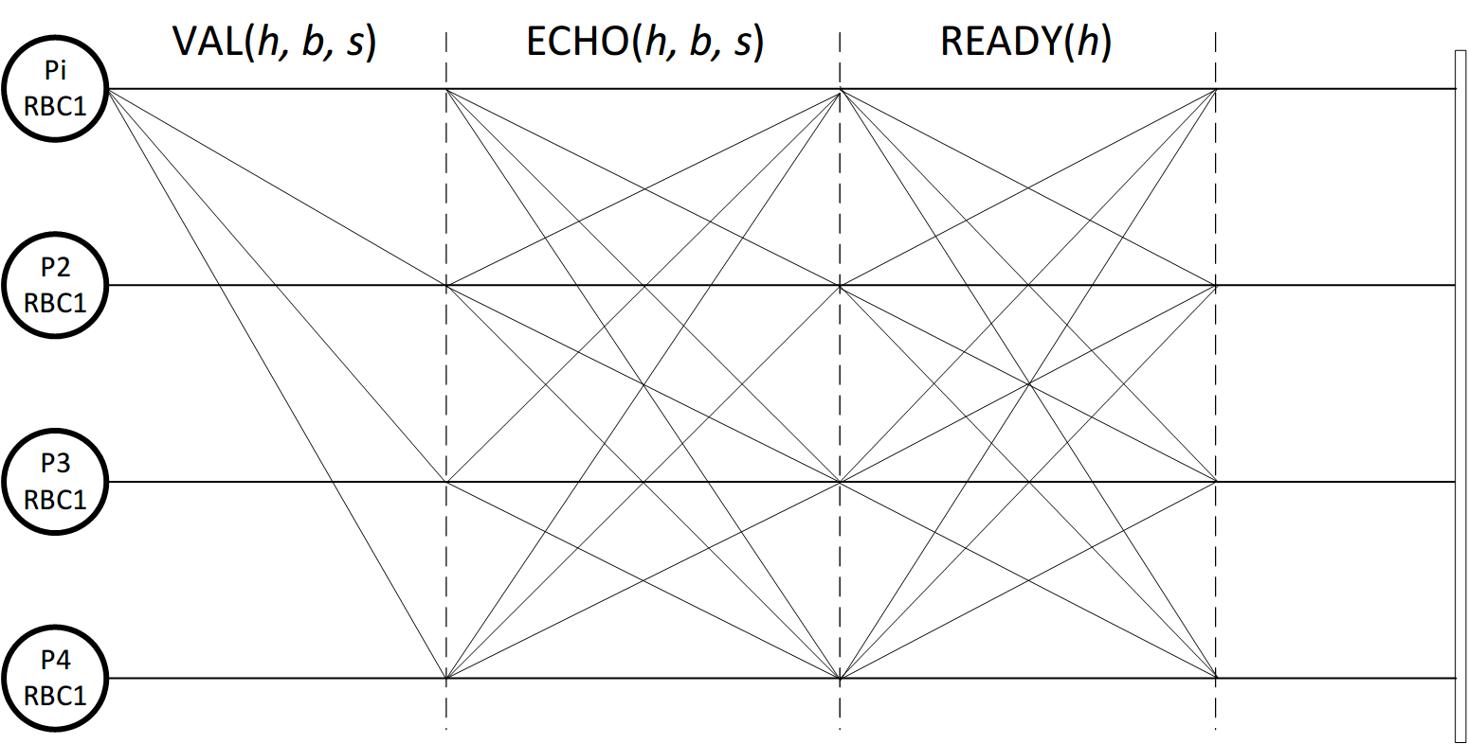

Slide 44
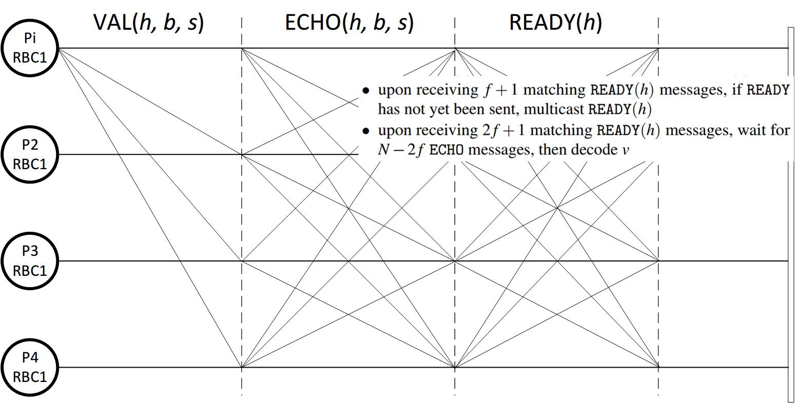

Slide 45
Asynchronous Binary Byzantine Agreement (ABA)
Deterministic asynchronous protocols are impossible
Flip a common coin to ensure the possibilistic asynchronous protocols
ABA guarantees three properties:
(Agreement) If any correct node outputs the bit b, then every correct node outputs b.
(Termination) If all correct nodes receive input, then every correct node outputs a bit
(Validity) If any correct node outputs b, then at least one correct node received b as input.

Slide 46
How does ABA working?
RBC provide the binary input for ABA
ABA received the binary bit as the input and broadcast the bit to other nodes
After the consensus, each ABA output a bit “Yes” or “No” represent to adopt or abandon its Vj output from RBC.

Slide 47
ABA Chart
Trust Dealer
r round
0/1
P1
RBC
Vj
ABA
Coin
0/1
r round
0/1
P2
RBC
Vj
ABA
Coin
0/1
r round
0/1
P3
RBC
Vj
ABA
Coin
0/1
r round
0/1
P4
RBC
Vj
ABA
Coin
0/1

Slide 48
ABA Chart
Trust Dealer
r round
0/1
P1
RBC
Vj
ABA
Coin
1
r round
0/1
P2
RBC
Vj
ABA
Coin
1
r round
0/1
P3
RBC
Vj
ABA
Coin
1
r round
0/1
P4
RBC
Vj
ABA
Coin
0

Slide 49
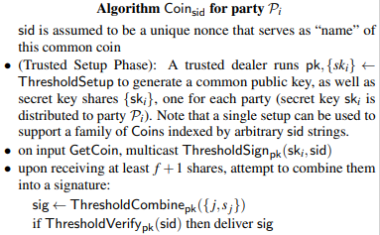
Flip a common coin
Running ABA instances will involve to flip a coin and distribute the coin value to every ABA instances.
Trusted dealer use threshold signature scheme to generate the coin and disseminate to all the nodes.
A common coin protocol should satisfies the following properties:
If f +1 parties call GetCoin(), then all parties eventually receive a common value, s.
The value s is uniformly sampled in the range {0,1} ,
and cannot be influenced by the adversary.
Until at least one party calls GetCoin(),
no information about s is revealed to the adversary

Slide 50
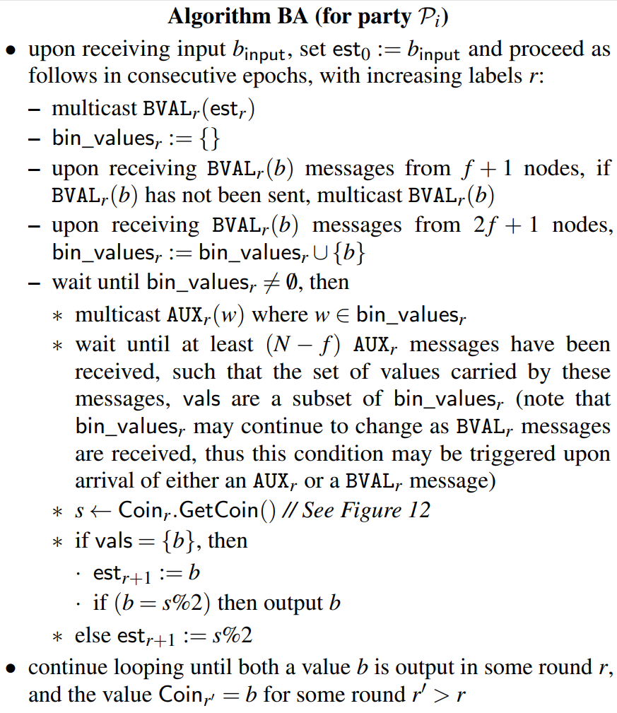
ABA
start
Broadcast BVAL(b)
Received f +1 BVAL(b) from other nodes, if it has not broadcast, forward the bit
Received 2f +1 BVAL(b) from other nodes, pack the bit in AUX(b) and broadcast
Received N - f AUX(b) from other nodes, put them into set vals
Flip a common to decide the final binary bit of the node

Slide 51
P1
P2
P3
P4
BVAL

Slide 52
P1
P2
P3
P4
BVAL
AUX

Slide 53
P1
Coin
...
P2
Coin
...
P3
Coin
...
P4
Coin
BVAL
AUX
Decision

Slide 54
Explanation
AUX broadcast is used to discard values sent only by Byzantine processes. Said in another way, the set vals of a correct process cannot contain an estimate value broadcast only by Byzantine processes.
Common flip coin protocol is used to avoid network partitions, attackers have the opportunity to send different users a vote of different values (or deliberately not vote), so that they can reach a consensus on different nodes.
Its expected running time is O(1), and in fact completes within O(k) rounds with probability 1 − 2 .
−k

Slide 56
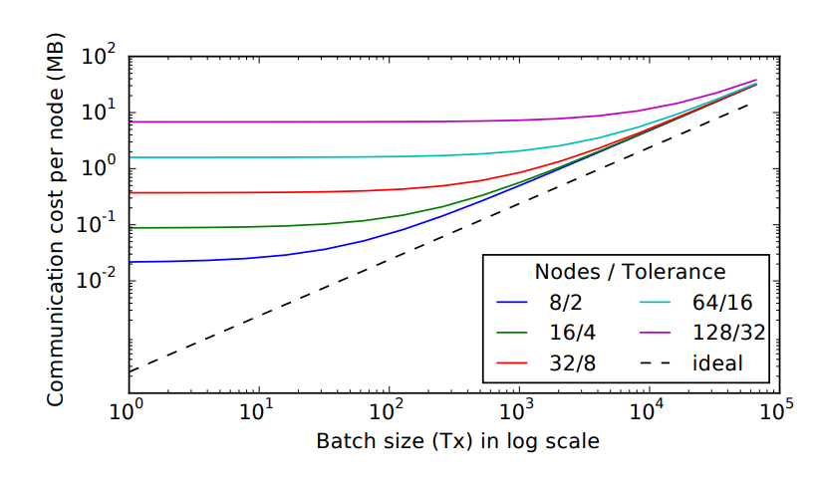
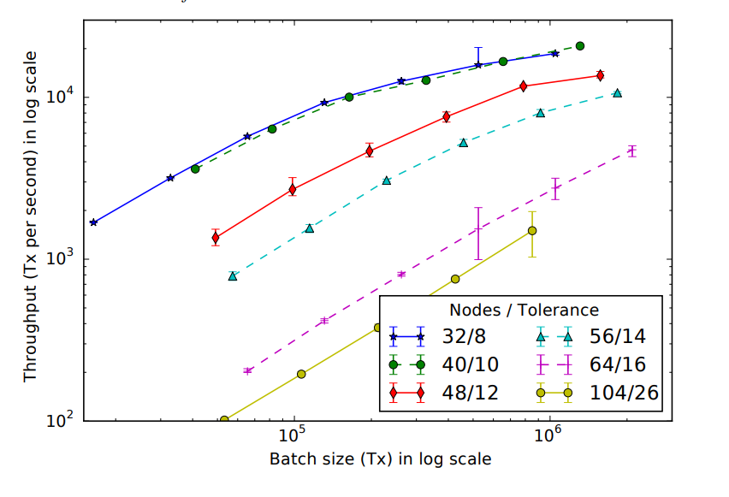
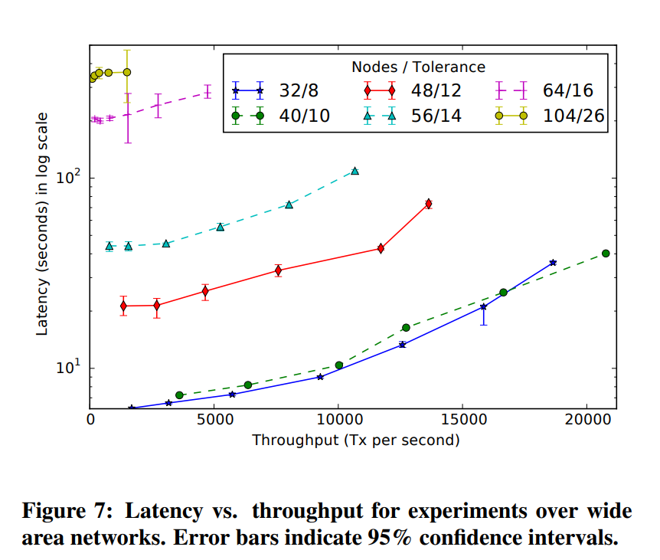
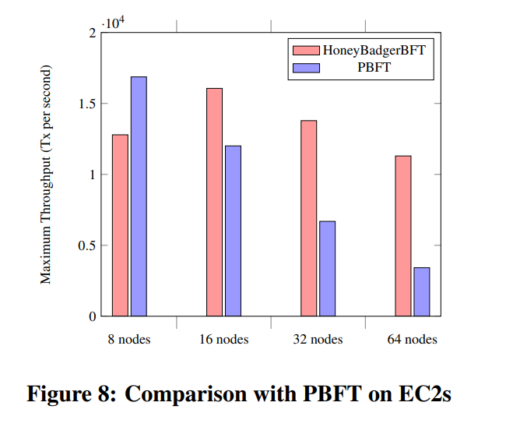
Benchmark and Evaluation on Amazon EC2

Slide 57
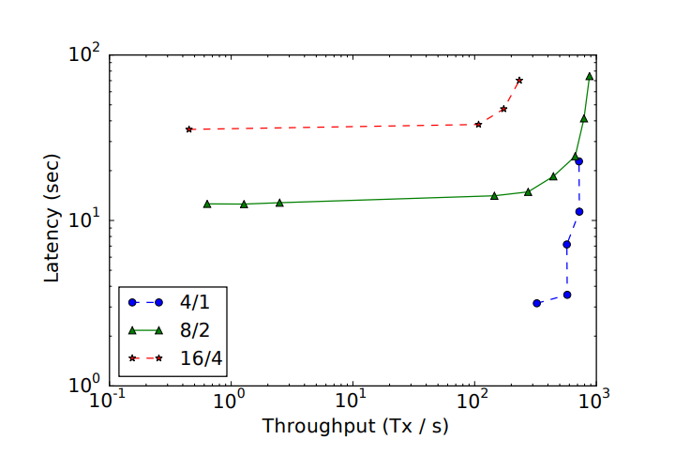
Benchmark and Evaluation on Tor
Tor network consists of approximately 6,500 relays, which are listed in a public directory service.
Tor enables “hidden services,” which are servers that accept connections via Tor in order to conceal their location.
High latency

Slide 58
Questions
When does RBC input 0 to ABA?
Upon delivery of value 1 from at least N − f instances of BA, provide input 0 to each instance of BA that has not yet been provided input.
Nodes abstain from proposing 0 until they are certain that the final vector will have at least N − f bits set.
RBC: – recompute Merkle root h’ and if h’ != h then abort
Chart flow
P1
P2
P3
P4
Forward
BVAL

Slide 59
Thank you for watching!
Weijia Wang, Zaoyi Zheng, Jinxiao Yu

Slide 60
Discussion:
The Honey Badger BFT Protocol
Author: Andrew Miller, Yu Xia, Kyle Croman, Elaine Shi, Dawn Song
Presenter: Zaoyi Zheng, Weijia Wang, Jinxiao Yu
Date: Nov 19, 2021

Slide 61
Honey Badger BFT Recap
The first practical asynchronous BFT protocol
Guarantees liveness without making timing assumptions
Favor throughput over latency
Core component: Asynchronous Common Subset (ACS)
Reliable Broadcast (RBC)
Asynchronous Binary Byzantine Agreement (ABA)

Slide 62
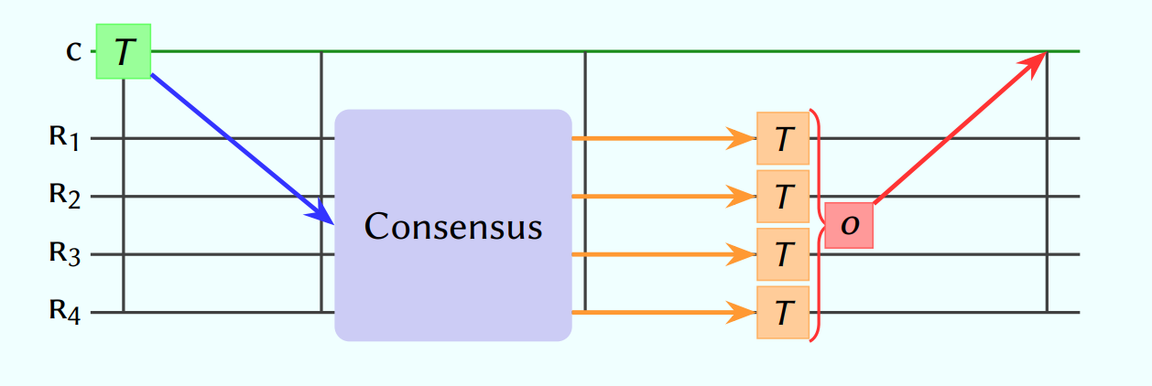
Asynchronous Common Subset (ACS)
Epochs number (r)
B1
V1
P1
RBC1
V1, V2, V3, V4
V1, V2, V3, V4
Blockr
B1, B2
B3, B4
buf1 = [....]
Threshold
Encryption
Threshold
Decryption
0/1
ABA1
1, 1, 1, 1
B2
V2
P2
V1, V2, V3, V4
V1, V2, V3, V4
Blockr
B1, B2
B3, B4
RBC2
Threshold
Decryption
buf2 = [....]
Threshold
Encryption
0/1
ABA2
1, 1, 1, 1
B3
V3
P3
V1, V2, V3, V4
V1, V2, V3, V4
Blockr
B1, B2
B3, B4
RBC3
Threshold
Decryption
buf3 = [....]
Threshold
Encryption
0/1
ABA3
1, 1, 1, 1
B4
V4
P4
RBC4
V1, V2, V3, V4
V1, V2, V3, V4
Blockr
B1, B2
B3, B4
buf4 = [....]
Threshold
Encryption
Threshold
Decryption
0/1
ABA4
PBFT
1, 1, 1, 1

Slide 63
ACS[r]
B1
V1
P1
RBC1
V1, V2, V3, V4
V1, V2, V3, V4
Blockr
B1, B2
B3, B4
buf1 = [....]
Threshold
Encryption
Threshold
Decryption
0/1
ABA1
1, 1, 1, 1
B2
V2
P2
V1, V2, V3, V4
V1, V2, V3, V4
Blockr
B1, B2
B3, B4
RBC2
Threshold
Decryption
buf2 = [....]
Threshold
Encryption
0/1
ABA2
1, 1, 1, 1
B3
V3
P3
V1, V2, V3, V4
V1, V2, V3, V4
Blockr
B1, B2
B3, B4
RBC3
Threshold
Decryption
buf3 = [....]
Threshold
Encryption
0/1
ABA3
1, 1, 1, 1
B4
V4
P4
RBC4
V1, V2, V3, V4
V1, V2, V3, V4
Blockr
B1, B2
B3, B4
buf4 = [....]
Threshold
Encryption
Threshold
Decryption
0/1
ABA4
1, 1, 1, 1

Slide 64
ACS[r]
B1
V1
P1
RBC1
V1, V2, Vf, V4
V1, V2, V4
Blockr
B1, B2
B4
buf1 = [....]
Threshold
Encryption
Threshold
Decryption
0/1
ABA1
1, 1, 0, 1
B2
V2
P2
V1, V2, Vf, V4
V1, V2, V4
Blockr
B1, B2
B4
RBC2
Threshold
Decryption
buf2 = [....]
Threshold
Encryption
0/1
ABA2
1, 1, 0, 1
Bf
Vf
P3
RBC3
buf3 = [....]
Threshold
Encryption
0/1
ABA3
B4
V4
P4
RBC4
V1, V2, Vf, V4
V1, V2, V4
Blockr
B1, B2
B4
buf4 = [....]
Threshold
Encryption
Threshold
Decryption
0/1
ABA4
1, 1, 0, 1

Slide 65
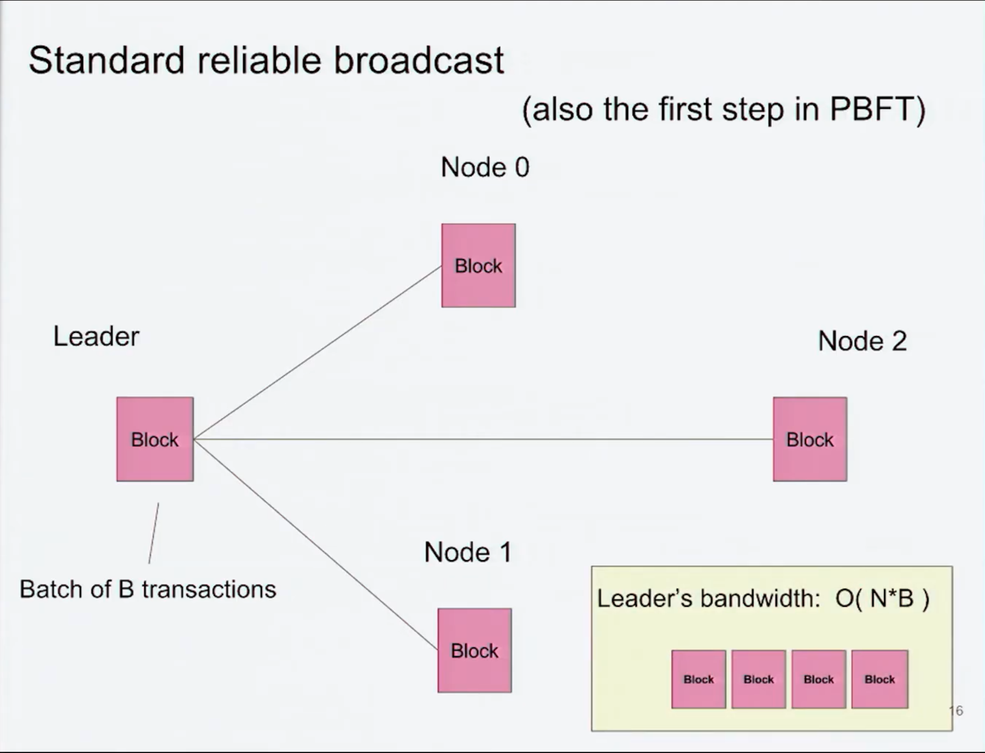
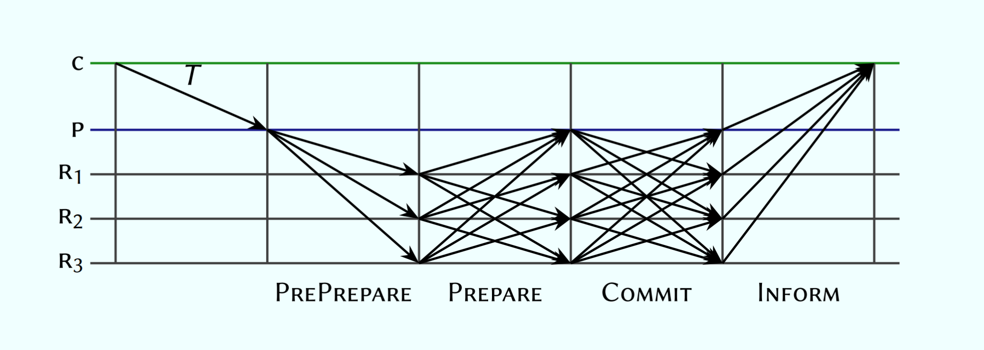
RBC: Why Reliable?
We assume each pair of nodes is connected by a reliable authenticated point-to-point channel that does not drop messages.
3T

Slide 66
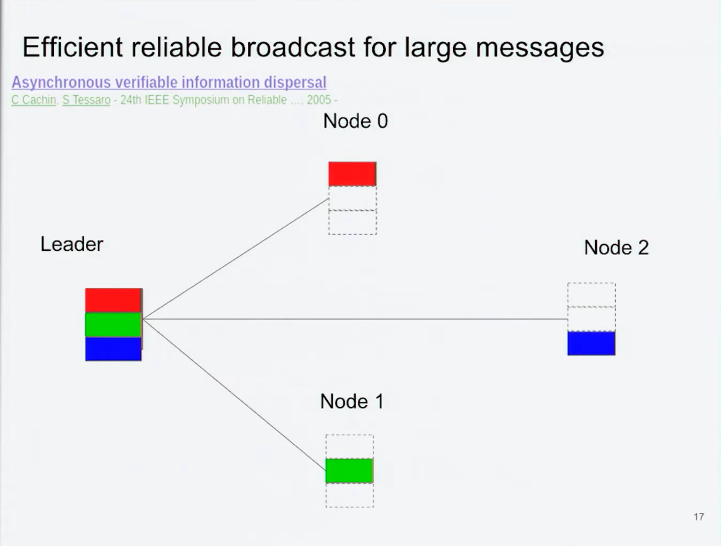
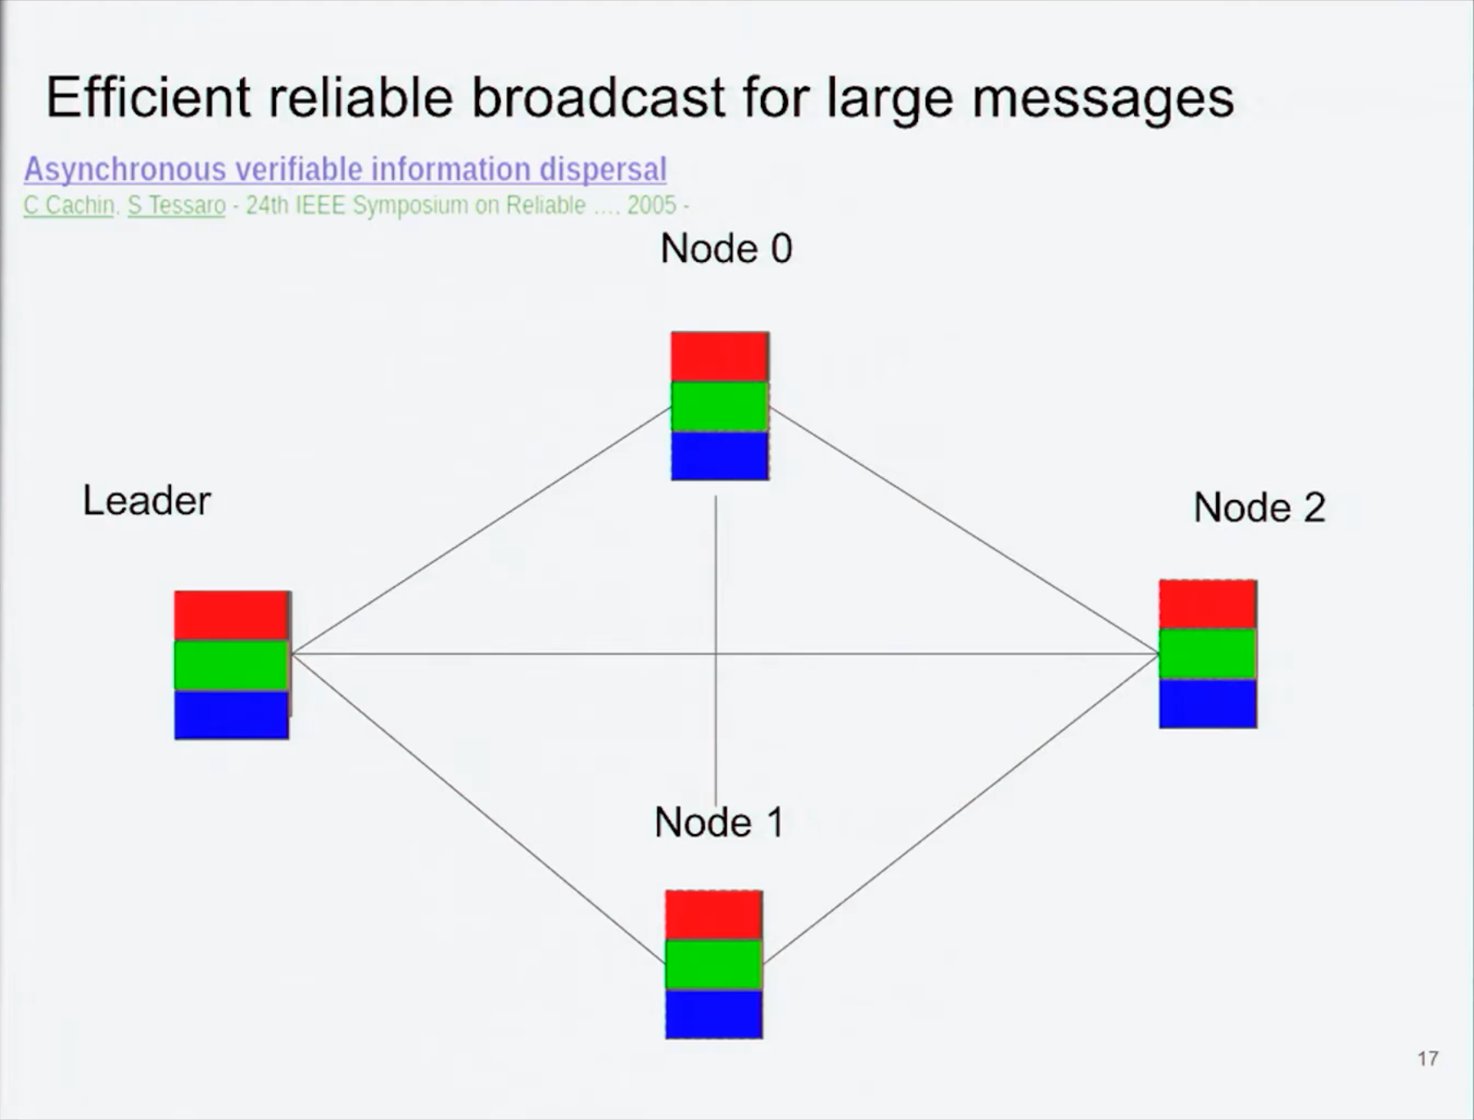
RBC: Why Reliable?

Slide 67
Benchmark and Evaluation
HBBFT distributes this load evenly among the network links, whereas PBFT bottlenecks on the leader’s available bandwidth.
3T

Slide 68
Questions
When does RBC input 0 to ABA?
Upon delivery of value 1 from at least N − f instances of ABA, provide input 0 to each instance of BA that has not yet been provided input.
Nodes abstain from proposing 0 until they are certain that the final vector will have at least N − f bits set.
RBC: – recompute Merkle root h’ and if h’ != h then abort.
P1
1
P2
1
P3
P4
Forward
BVAL

Slide 69
Questions
How to achieve transaction ordering in HBBFT?
The nodes receive transactions as input, and their goal is to reach common agreement on an ordering of these transactions.
HBBFT random selection of B/N transactions from the first B elements of buffer.
The protocol may commit up to B transactions in a single epoch. However, some correct nodes may propose overlapping transaction sets.
Node 1:
1
2
3
4
5
6
7
8
Node 2:
1
2
3
4
5
6
7
8
Total:
1
2
3
4
5
6
7
8
Node 3:
1
2
3
4
5
6
7
8
Node 4:
1
2
3
4
5
6
7
8

Slide 70
Thank you for watching!
Weijia Wang, Zaoyi Zheng, Jinxiao Yu

